Slide 1
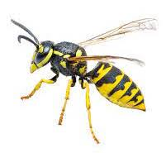
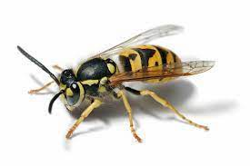
Yellowjackets
Portland Urban Beekeepers
March 1, 2023
Brian Fackler
Cornell University Master Beekeeper
Washington State Master Beekeeper

Slide 2
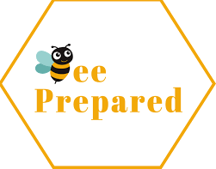
Agenda
What are Yellowjackets
Identification
Foraging
Life Cycle and Behavior
Integrated Pest Management
Cultural Control
Physical Control
Chemical Control

Slide 3
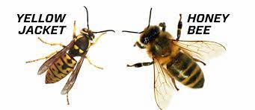
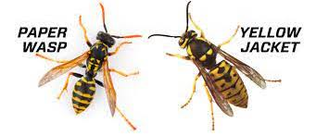
Identification
Common name for social predatory wasps of the genera western yellowjacket (Vespula Pensylvanica), German yellowjacket (Vespula Germanicaa0 and Common yellowjacket (Vespula Vulgaris) with distinctive alternating black and yellow stripes – workers ½” long – queen ¾” long - narrow body with pinched waist - hairless body and smooth legs – fierce and most common insects to sting humans – the stinger barbs are smaller than honey bee’s and usually does not become fixed in flesh and can be withdrawn to sting again.

Slide 4
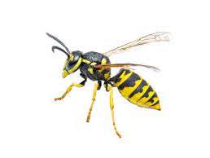
Foraging
Yellowjackets forage for sugar in the form of nectar, fruit juice and tree sap. They seek meat protein to feed young (chewed up meat, insects or fish) and in return the larvae exude a sugar substance the adults consume till the end of august when few larvae are in the nest – the adults than switch from meat for the brood to sugar for their own food.

Slide 5
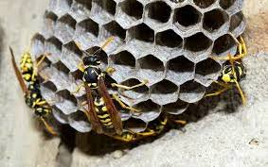
Life Cycle and Behavior
Yellowjackets are semi-social colony-nesting insects – in the spring the overwintered queens emerge and select a nest site (underground hole, opening in a structure or arial nest site) to build a grey paper nest from wood a vegetable fibers that are collected and chewed by the workers – the queen stays in the nest and lays eggs the entire growing season – in August to October new males and queens are produced and mate - the mated queens will find a location for overwinter dormancy – after the temperature drops to 32f the colony dwindles and dies. In late summer the yellowjacket population is large and the typical food supply is declining – aggressive scavenging behavior become a nuisance to honey bee colonies when they rob honey and larvae.

Slide 6
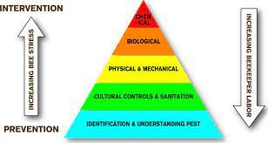
Integrated Pest Management
An integrated pest management system that included cultural methods to ensure strong colonies, is a good technique for preventing and control of yellowjacket damage.

Slide 7
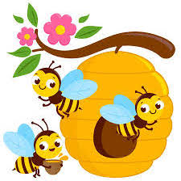
Cultural Control
Maintaining a strong colony of honey bees will assist in keeping robbing yellowjackets from the bee hive – frequent inspections and beekeeper actions to control varroa mites and maintain a productive queen are essential

Slide 8
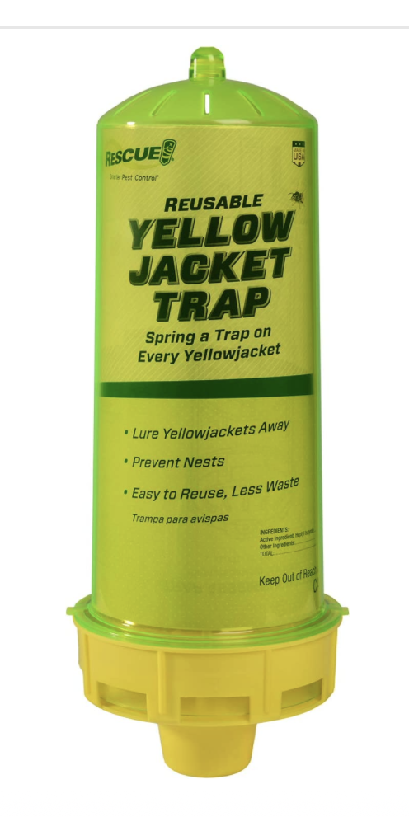
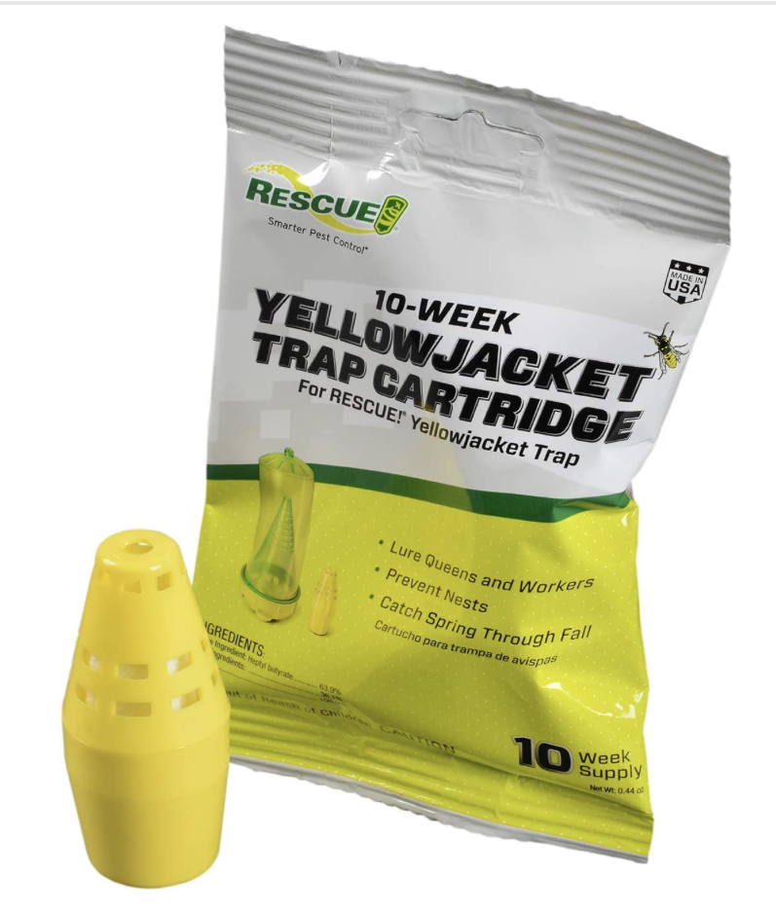
Physical Control
Late summer entrance reducers and or robbing screen will help protect a small colony from robbing – also close the upper entrance. From early March to late October install multiple traps and replace bait cartridge every ten weeks, such as the “Rescue Reusable Yellowjacket Trap”.

Slide 9
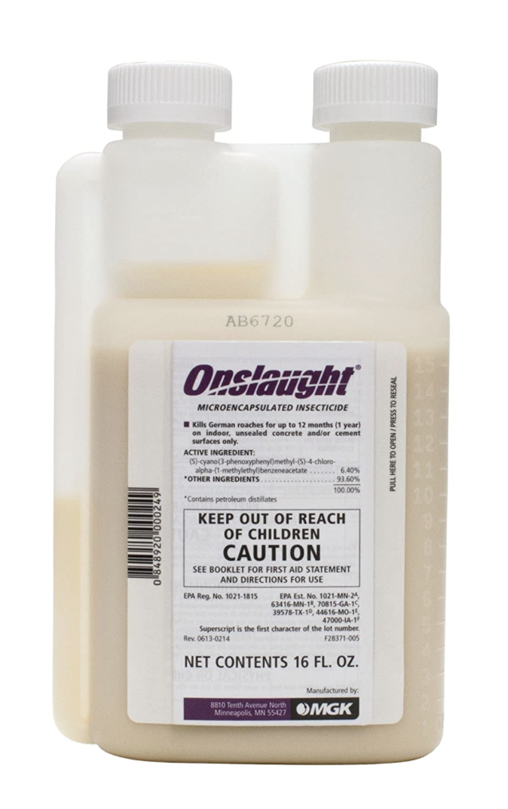
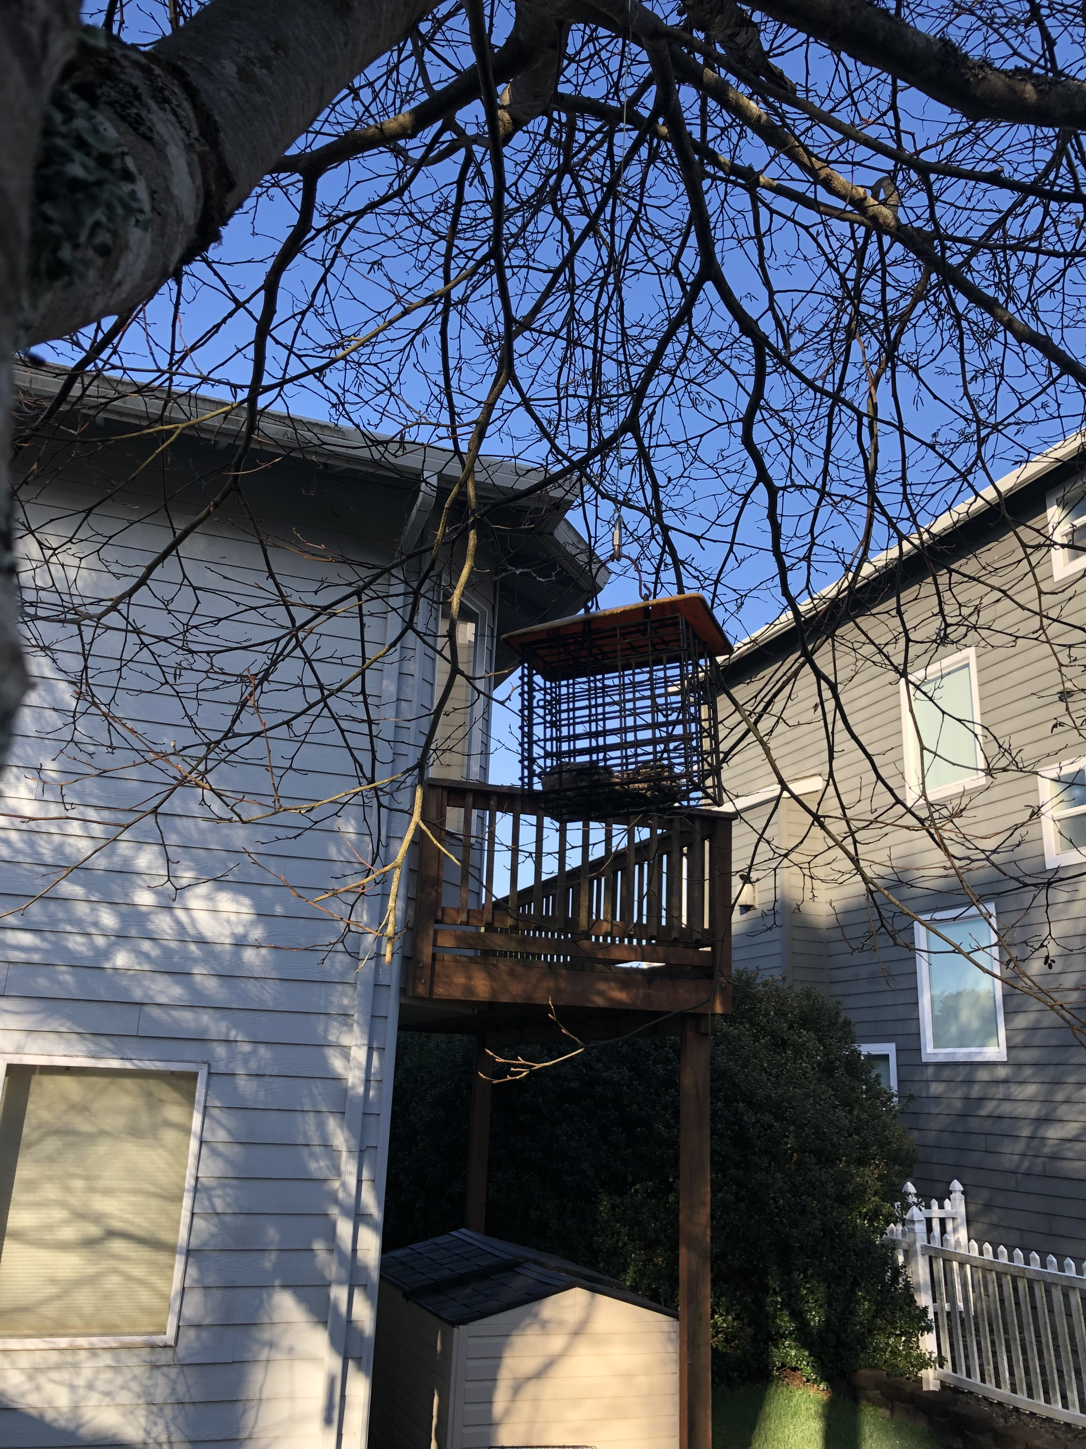
Chemical Control
From early March to late October purchase “greasy” deli chicken drumsticks - add small amount of both liquid yellowjacket attractant and Onslaught insecticide - place in a bird suet feeders which are hung near hives – each month the treated chicken is replaced – yellowjackets chew the treated chicken meat then return back to the hive to feed larvae which kills the colony.

Slide 10
Key Points to Take Home
Yellowjackets are a threat to both humans and honey bees
You can control yellowjackets with integrated Pest Control
Success requires your pro-active season long effort
Your bees will appreciate your control of this pest

Slide 11
References
Honey Bee Biology and Beekeeping, third edition 2022 by D.W. Caron and L.J. Connor – pages 57
Honey Bee Disease & Pests, Canadian Association of Professional Apiculturists by D. Ostermann & G. Williams – pages 41-42
What Do You Know everything you’ve ever wanted to know about honey bees, beekeeping and the world they inhabit, 2003 by C. H. Collison – pages 5-27
ABC and XYZ of Bee Culture 42nd edition 2020 – pages 428-429
Yellowjacket – Oregon State University https://pubs.extension.oregonstate.edu/em9093/yellowjecket
Protecting Honey Bees from Yellowjacket Wasps – Oregon State University – EM 9211 July 2018 – C. Breece,
D. Wyns and R. Sagili

Slide 12
Questions?

