Slide 1
Welcome
March 10, 2025
Paul Longwell
Cornell University Master Beekeeper
Montana University Master Beekeeper
Washington State Master Beekeeper
Notes:
My name is Paul Longwell I live in the Pacific northwest and have been keeping bees for 17 years.
I picked this subject

Slide 2
How do bees use sound/vibration to communicate ?

Slide 3
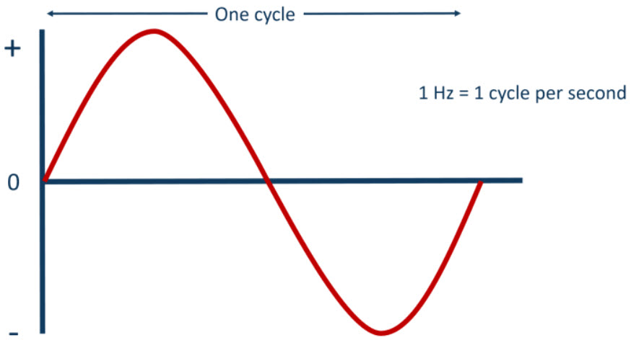
Sound vibrations are measured in Hertz (Hz)
Human hearing Range 20 Hz – 17000 Hz
Honeybee hearing Range 10 Hz- 1000 Hz

Slide 4
Importance of the waggle Dance

Slide 5
Waggle dance is just one form of vibration communication using sound/vibration to talk with their hive mates.
Karl Von Frisch 1940’s
Notes:
Think about how bees communicate in the dark! Food and water sources, new hive locations when bees
Decide to swarm. It’s all done with vibrations within the hive.

Slide 6
In a hive most of the dances that
we see going on are to communicate:
nectar and pollen as their food source
new nest sites
water on a really hot day
tree resin when they need to plug up holes in the hive
anytime there's a resource that the colony needs

Slide 7
Is the Waggle Dance The Only form of Bee communication ?

Slide 8
If the Waggle Dance Is performed in the dark! How do they share the dance information?

Slide 9
Notes:
Gut if it’s dark inside the hive How do they interpret the dance?

Slide 10
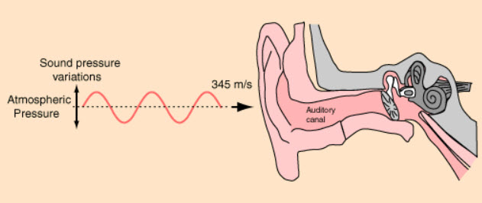
If the Honeybee do not have any ears?
How do they hear sounds ?
Notes:
The Johnston’s organ (A) and subgenual organ (B) are the primary receptors for vibroacoustic signals (sound). Hunt and Richard (2013)

Slide 11
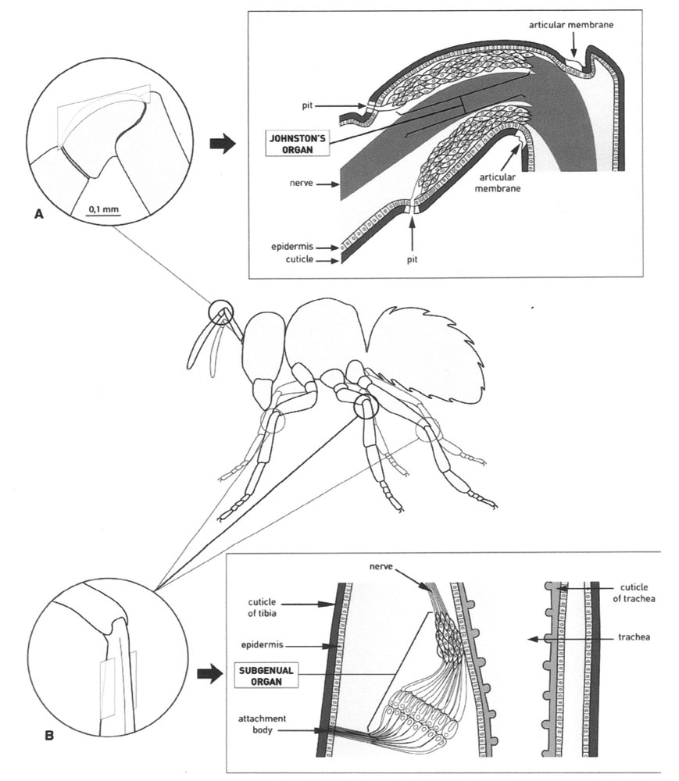
Honeybee Vibration Sensors
The Johnston’s organ (A) and subgenual organ (B) are the primary receptors for vibroacoustic signals (sound). Hunt and Richard (2013)
Notes:
The subgenual organ is an organ in insects that is involved in the perception of sound. The name (Latin sub: "below" and genus: "knee") refers to the location of the organ just below the knee in the tibia of all legs in most insects.

Slide 12
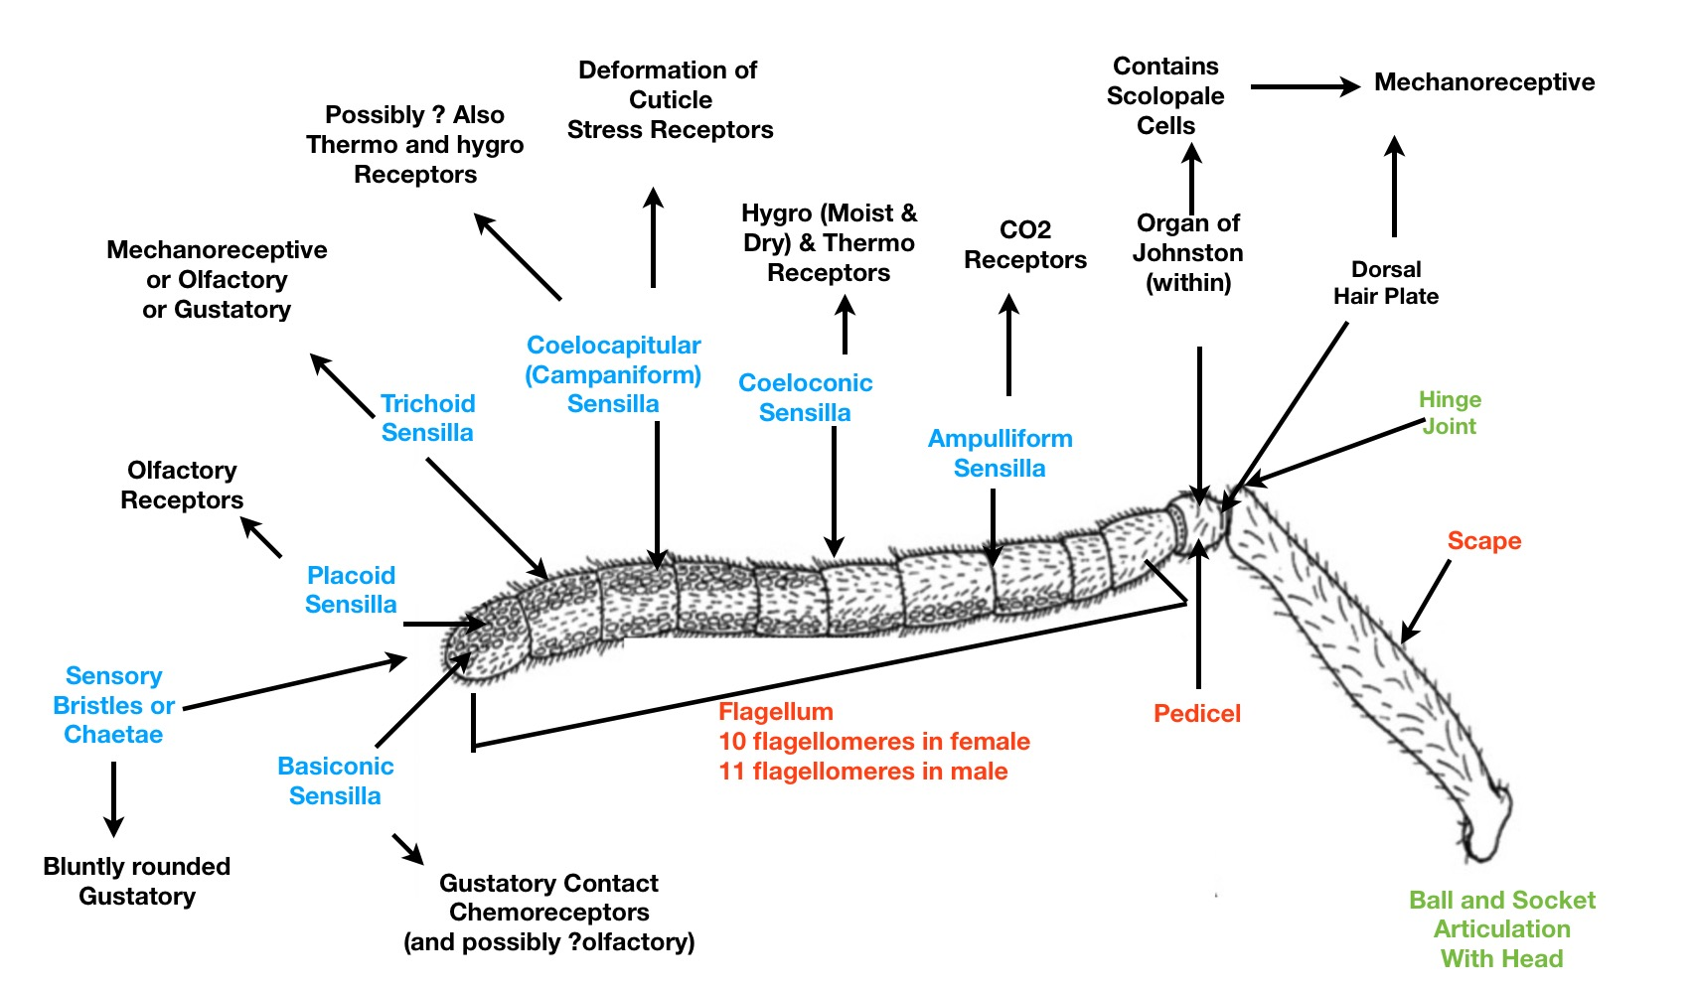
Johnston Organ
The Johnston’s organ is one of the primary receptors for vibroacoustic signals (sound). Hunt and Richard (2013)
Notes:
Dancing worker bees share the location of nearby food sources by emitted airborne sound signals. These are detected by other workers using the Johnston’s organ in the pedicel of the antennae. The organ consists of 240 sensory complexes the include bristles which deform along efferent directions to detect air movement, including sounds.

Slide 13
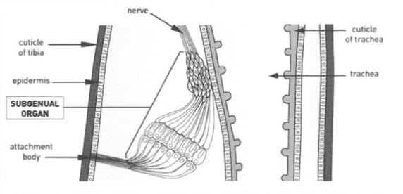
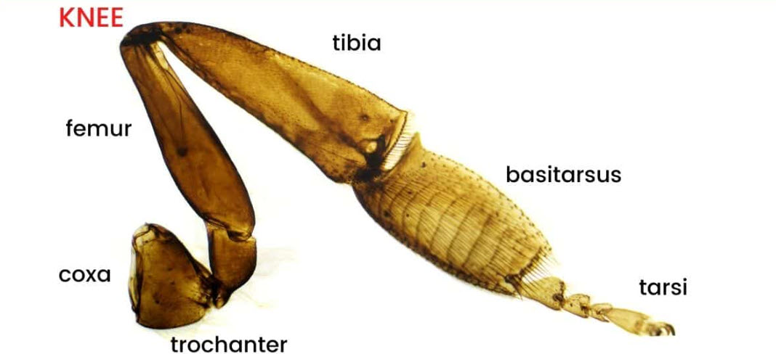
Subgenual Organ
The Subgenual organ is one of primary receptors for vibroacoustic signals (sound). Hunt and Richard (2013)
Notes:
Located in each of the knee joints six legs.
The subgenual organ of the honeybee (Apis mellifera) is suspended in a haemolymph channel in the tibia of each leg. When the leg is accelerated, inertia causes the haemolymph (and the subgenual organ) to lag behind the movement of the rest of the leg.
The subgenual organ (SGO) is an important scolopidial organ present in the tibia of most insects, which is most sensitive to substrate vibrations [13] but may also respond to airborne sound [14–18].Oct 1, 2014

Slide 14
During the Waggle dance
the Dancer
Moves her body in 15 Hz waggling motions side to side
While vibrating her wings in short 20 ms pulses, at frequencies from 200 to 300 Hz
Michelsen 1987
Notes:
Think about how bees communicate in the dark! Food and water sources, new hive locations when bees
Decide to swarm. It’s all done with vibrations within the hive.

Slide 15
During the Waggle dance the Dancer
These Airborne sounds are received by close followers of the dance with their antennas
The vibration of the dance is also transmitted through the wax comb where it’s picked up by the subgenal organs in the legs
Hunt and Richard 2013
Notes:
Think about how bees communicate in the dark! Food and water sources, new hive locations when bees
Decide to swarm. It’s all done with vibrations within the hive.

Slide 16
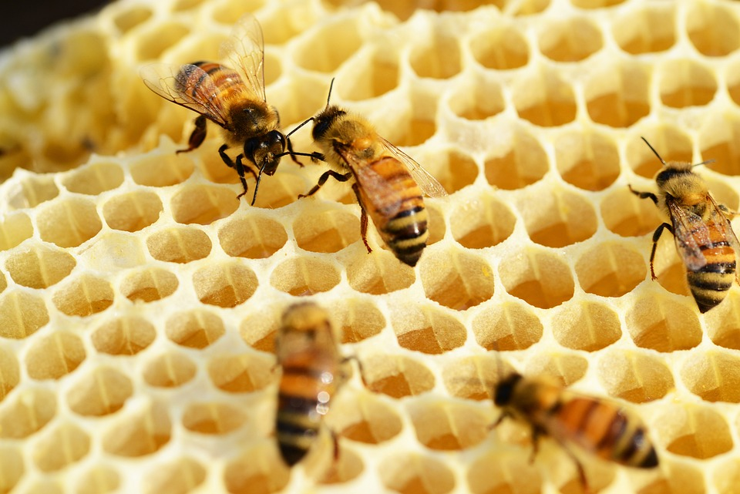
Honeybee comb near the entrance is conveniently left with open cells.
Bees use this as a dance floor to perform the waggle dances.
Why empty comb?
Empty open cell comb transmits the vibration better than full cells.
Sandeman 1996
Notes:
Empty comb cells transmit vibrations throughout the hive to alert everyone to danger, food, and
Other important information.

Slide 17
Worker Bees Piping Signals
Tremble dancers (300-500 Hz)
Tremble: Signal alerts hive mates they need to stop and listen.
Armbruster 1922

Slide 18
Worker Bees Piping Signals
Shaking Signal ( 16-20 Hz)
Shaking: All workers even 2 day old can perform the shaking signal
This is done by grabbing the recipient and vibrating.
Armbruster 1922
Notes:
All workers can perform the shaking signal, even workers as young as 2 days old, but the majority of shaking signals are administered by older workers7,8. To perform a shaking signal, a worker bee grabs onto a recipient and vibrates at 16.3 ± 5.8 Hz for 1.2 ± 0.3 s9. While only workers transmit the shaking signal, all individuals in the colony can be recipients of the signal: workers, drones, and queens6. The response, however, varies depending on the recipient10. When workers are shaken, they increase their movement, change their trajectories within the nest, and those of foraging-age move to the dance floor (the area of the nest where successful foragers perform waggle dances to advertise foraging sites)6,11. When drones are shaken, they increase their movement, are fed and groomed more, and spend more time being fed and groomed than drones that are not shaken12. When a virgin queen is shaken, she is more successful at eliminating her rivals, and more likely to become the new queen of the colony than virgin queens that are not shaken13. When mated queens are shaken, they prepare to fly away with a swarm of workers and follow them to a new home14.

Slide 19
Worker Bees Piping Signals
Forager (200 – 350 Hz)
Returning Forager: Obtain attention of food receiver bees to communicate quality and location of food sources
Armbruster 1922

Slide 20
Worker Bees Piping Signals
Nest site scout (100-2000 Hz)
Scout: Stimulates swarm to prepare for lift-off
Armbruster 1922

Slide 21
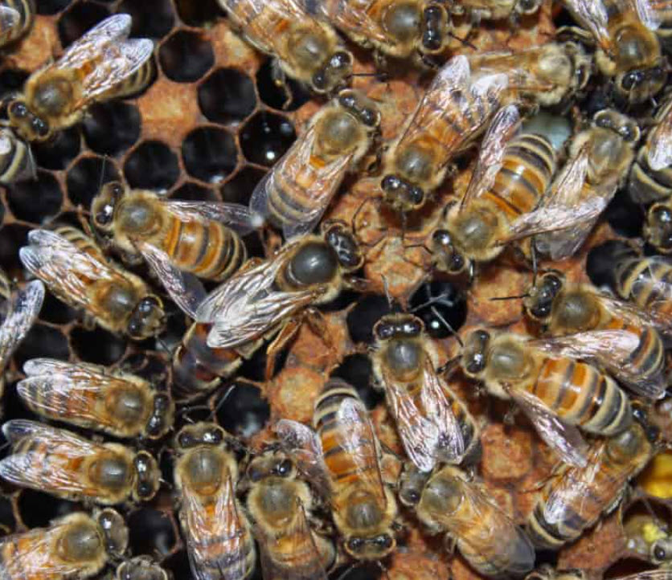
Queen Piping Signals
The Queen has two primary Piping signals she makes.
The sound is made using her thorax pressed against the wax comb.
Schneider 2003

Slide 22
Queen Piping Signals
Emerging queen tooting @ (350-500 Hz)
Schneider 2003
Notes:
Once a new queen emerges, she stops quacking and starts tooting.
The workers feel the tooting vibration and move to keep the other queens captive. They do this by repairing the wax caps on the queens’ cells in thehoneycomb.

Slide 23
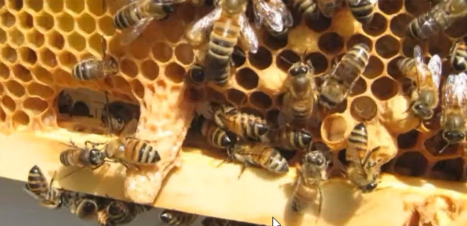
Queen Quacking Signal
Capped Queen Cell
queen quacking @
(300-350 Hz)
Schneider 2003

Slide 24
Queen Bee Signals
Emerging queen tooting @ (350-500 Hz)
Capped cell queen quacking @ (300-350 Hz)
Schneider 2003
Notes:
Once a new queen emerges, she stops quacking and starts tooting.

Slide 25
Conclusion
Sounds are used by the bees to communicate within the hive.
As Beekeepers, using sensors in the hive can help reveal useful information to better understand the colony health status and to detect sudden variations.

Slide 26
References
Response characteristics of vibration-sensitive interneurons related to Johnston's organ in the honeybee, Apis mellifera. Hiroyuki Ai, Jürgen Rybak, Randolf Menzel, Tsunao Itoh. First published: 06 May 2009 https://doi.org/10.1002/cne.22042
2. Transmission Of Vibration Across Honeycombs and Its Detection By Bee Leg Receptors, D. C. Sandeman, J. Tautz, M. Lindauer J Exp Biol (1996) 199 (12): 2585–2594. https://doi.org/10.1242/jeb.199.12.2585
3. The vibration signal, modulatory communication and the organization of labor in honeybees, Apis mellifera. Stanley S. Schneider and Lee A. Lewis Apidologie 35 (2004) 117-131. https://doi.org/10.1051/apido:2004006
4. Relationship between Relative Hive Entrance Position and Dance Floor Location (2014). Corrigan, Chelsea E., Undergraduate Honors Theses. Paper 474. https://dc.etsu.edu/honors/474
5. The Use of the Vibration Signal and Worker Piping to Influence Queen Behavior during Swarming in Honey Bees, Apis mellifera. Pierce, A.L., Lewis, L.A. and Schneider, S.S. (2007), Ethology, 113: 267-275. https://doi.org/10.1111/j.1439-0310.2006.01314.x
6. 32 Vibratory and Airborne-Sound Signals in Bee Communication (Hymenoptera)
https://www.researchgate.net/publication/268000846_32_Vibratory_and_Airborne-Sound_Signals_in_Bee_Communication_Hymenoptera
7. Sound and vibrational signals in the dance language of the honeybee, Apis mellifera. Michelsen, A., Kirchner, W.H. & Lindauer, M. Behav Ecol Sociobiol 18, 207–212 (1986). https://doi.org/10.1007/BF00290824
8. Influences of queen piping and worker behaviour on the timing of emergence of honeybee queens. H.J. Grooters Insectes Sociaux, 1987, Vol. 34, No. 3, 181-193 https://doi.org/10.1007/BF02224083
9. On the Importance of the Sound Emitted by Honey Bee Hives, by Alessandro Terenzi †ORCID,Stefania Cecchi *,†ORCID and Susanna Spinsante †ORCID, Dipartimento di Ingegneria dell’Informazione, Universitá Politecnica Delle Marche, 60131 Ancona, Italy Vet. Sci. 2020, 7(4), 168; https://doi.org/10.3390/vetsci7040168

Slide 27
THANK YOU!
Do you have any questions?
Paullongwell@comcast.net

