Slide 1
Splits
A Rough Introduction

Slide 2
Boozy Dog Farms
Jordan Bramwell (Owner/Operator, LLC)
jordan.d.bram@gmail.com
Notes:
Awkwardly talk about yourself.

Slide 3
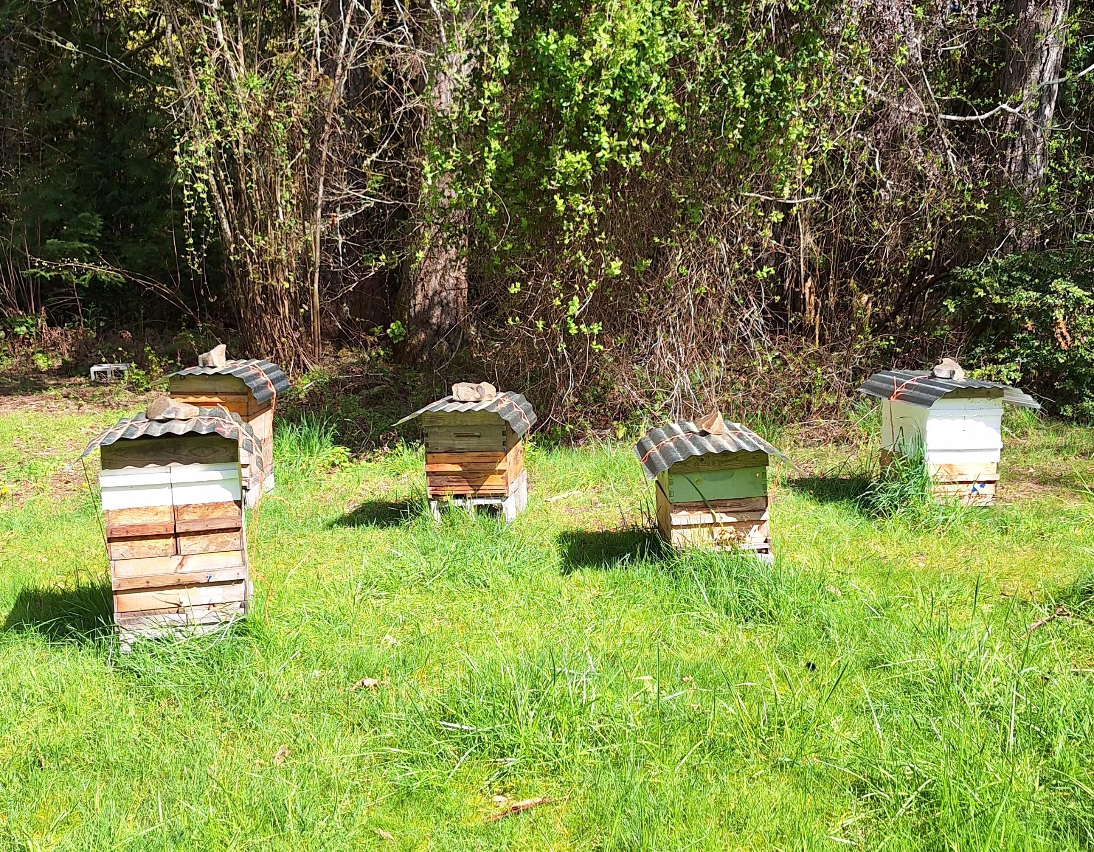
Overwintering is a Prerequisite for Making Splits
1: Excellent Mite Control
2: Proper Nutrition
3: Replacing Queens When Appropriate
…
…
…
4: Moisture Control
Fat healthy bees tend to survive even when conditions are rough.
Sick skinny bees tend to die no matter what you do to try and save them.
Focus on overall honey bee health.
Notes:
If you’re losses are consistently over 50% then you need to sort that out first.

Slide 4
Why Make Splits?
Bees are expensive.
Replace losses (plan for losses/failure rate).
Grow your apiary.
It’s fun!~
Notes:
Always start with why. What are your goals and values?

Slide 5
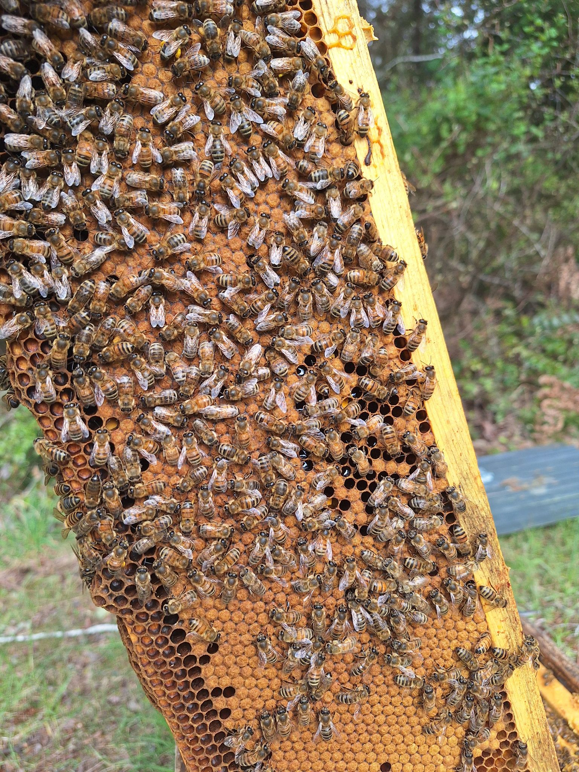
Essentials of Splits
Queens.
Viable amount of bees and brood.
Appropriate housing.
Appropriate feed.
Timing and context.
Notes:
Talk about how context matters.

Slide 6
Types of Splits We’ll be Talking About Today
Walk-away.
Nucs with queen cells.
Nucs with mated queens.
Notes:
This is not an exhaustive list. This is the absolute basics.

Slide 7
Walk-Away Split
All of life is trade-off
Take a strong healthy colony and divide it roughly in half.
Take the hive with the old queen and move her at least 2 miles away.
Make sure the other box has eggs and young larvae so they can raise a queen.
Make sure both hives are viable with plenty of food. Especially the hive raising the queen.
Check for queen-right/eggs in about a month (16 days to emergence, about 14 more to mate and start laying).
Pros
Simple.
Cons
Resource expensive.
Time expensive.
Relatively high failure rate.
Notes:
A queen from an egg takes 16 day to emergence, 14 more to mate and start laying, those eggs take 21 days to emerge. = 51 days to new bees.

Slide 8
Nucs With Queen Cells
Harvest brood and nurse bees from strong healthy colonies.
Place brood, bees, and food into nuc box (at least 2-3 frames of mostly capped brood with nurse bees).
Place ripe queen cell between brood frames.
Add resource frame: honey and pollen.
Feed.
Pros
Much less resource expensive than walk-away split.
Queen cells are cheap when available.
Cons
Sometimes mating fails.
Need a source of queen cells.

Slide 9
Nucs With Mated Queen
Harvest brood and nurse bees from strong healthy colonies.
Place brood, bees, and food into nuc box (at least 2-3 frames of mostly capped brood with nurse bees).
Place mated queen with candy plug between brood frames.
Add resource frame: honey and pollen.
Feed.
Pros
Much less resource expensive than walk-away split.
Takes less time to brood production than queen cells.
Cons
Mated queens can be expensive.

Slide 10
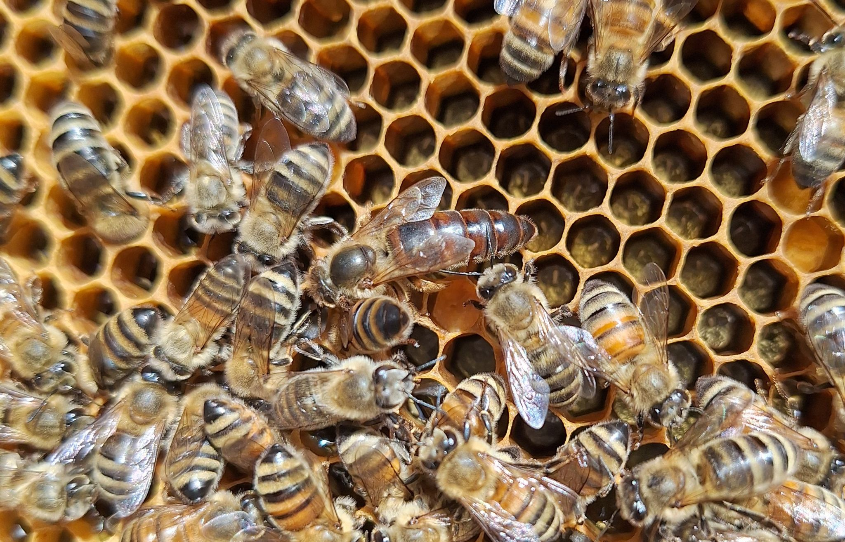
A Quick Note About Sourcing Queens
Buy cells or mated queens.
Opportunistically use swarm cells.
Force them to make emergency cells.
Set up cell builders and graft.

Slide 11
Questions?

